Slide 1


Noida Institute of Engineering and Technology, Greater Noida
Introduction to Digital Marketing
Unit: 1
Subject: Digital Marketing
AOE0667
Manisha Pundir Sajwan
(Asst. Professor)
CSE DS Department
Course Details B Tech 6th Sem

Slide 2

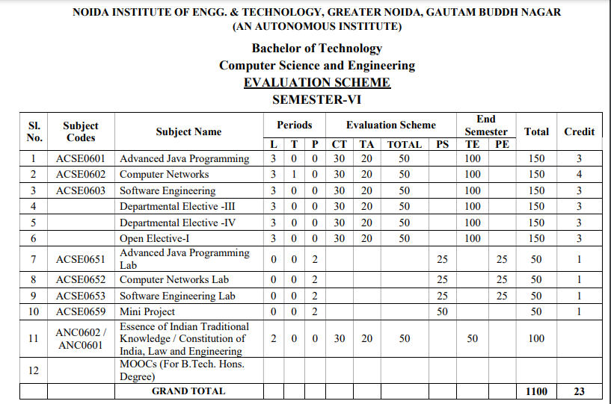
Evaluation Scheme

Slide 3
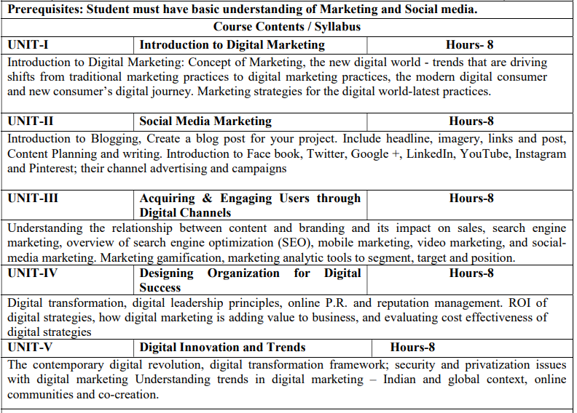
Syllabus

Slide 4
Branch wise application
With the advent of new technologies, the field of Marketing has seen a paradigm shift over the years.
Though it is still in use, businesses across the world have switched from traditional modes of marketing to digital marketing.
This, in turn, has created many new opportunities for companies to expand their business and has created tremendous employment opportunities across sectors.
From Content Curation and Management to Social Media Marketing and Brand Management, a career in Digital Marketing can take you in several directions.
Top Job Profiles: Digital Marketing Manager, Social Media Manager, Content Writer

Slide 5
Course Objective
Provide understanding of digital and social media marketing practices
Provide understanding of different social media platforms
Impart learning on various digital channels and how to acquire and engage consumers online
Provide insights on building organizational competency by way of digital marketing practices and cost considerations
Develop understanding of the latest digital practices for marketing and promotion

Slide 6
Course Outcome
Upon completion of the course, the student will be able to:
Develop an understanding of digital and social media marketing practices
Develop understanding of the social media platforms
Acquire the skill to acquire and engage consumers online
Develop understanding of building organizational competency by way of digital marketing practices and cost considerations
Develop understanding of the latest digital practices for marketing and promotion

Slide 7
Program Outcomes (POs)
PO1: Engineering knowledge
PO2: Problem analysis
PO3: Design/development of solutions
PO4: Conduct investigations of complex problems
PO5: Modern tool usage
PO6: The engineer and society
PO7: Environment and sustainability
PO8: Ethics
PO9: Individual and team work
PO10: Communication
PO11: Project management and finance
PO12: Life-long learning

Slide 8
Program Specific Outcomess (PSOs)
PSO1: To apply knowledge of basic sciences and biotechnological techniques.
PSO2: To Design, optimize, analyze & scale up bioprocesses to develop useful products with societal consideration.
PSO3: To generate, analyze & interpret biological data using in silico & other relevant approaches.

Slide 9
CO-PO and PSO Mapping
CO/ P O | PO1 | PO2 | PO3 | PO4 | PO5 | PO6 | PO7 | PO8 | PO9 | PO10 | PO11 | PO12
CO 1 | 1 | 2 | 3 | 3 | 3 | 2 | 2 | 3 | 3 | 2 | 3 | 3
CO/ P SO | PSO1 | PSO2 | PSO3
CO 1 | 2 | 2 | 2

Slide 10
Program Educational Outcomes (PEOs)
PEO1: Students will acquire knowledge and skills in the frontier areas of biotechnology and will be able to solve societal problems individually and in teams.
PEO2: Students will be able to think creatively and ethically about the use of biotechnology to address local and global problems.
PEO3: Students will be able to implement the engineering principles to biological systems for development of industrial applications, as well as entrepreneurship skills to start biotech industry.

Slide 11
Brief Introduction about the subject with videos
Digital marketing is rapidly growing force in the present marketing domain and is set be the future of marketing. It has resulted in numerous opportunities and avenues for advertising and marketing both in domestic and international business environment. Therefore, there is a need to understand the fundamentals of Digital Marketing and to inculcate the skills of digital marketing among students. In this background, a course on Digital Marketing has been designed which aims to build conceptual foundation of digital marketing and to develop the students’ skills to plan, implement and monitor digital marketing campaigns in globalized environment.
https://youtu.be/FXYjur6abww

Slide 12
Unit Content
Introduction to Digital Marketing
Concept of Marketing
New digital world - trends that are driving shifts from traditional marketing practices to digital marketing practices
The modern digital consumer and new consumer’s digital journey
Marketing strategies for the digital world-latest practices.

Slide 13
Unit Objective
To get detailed understanding of digital and social media marketing practices

Slide 14
Topic Objective
Topic | Objective
Introduction to Digital Marketing: Concept of Marketing | To understand the significance of digital marketing
New digital world - trends that are driving shifts from traditional marketing practices to digital marketing practices | To understand the difference between traditional marketing practices to digital marketing practices
The modern digital consumer and new consumer’s digital journey | To understand the transition between consumer to modern digital consumer
Marketing strategies for the digital world-latest practices | To understand marketing strategies

Slide 15
Traditional Marketing Vs Digital Marketing (CO1)
Traditional Marketing
Digital Marketing
Offline, door to door
Reach is limited
More cost involved in traditional marketing
Needs physical infrastructure
Slow response to consumer
Less convenient for customer
Analytics not available
Online, over the internet
Wider reach than digital marketing
Less costly
Does not need physical infrastructure
Fast response to consumer
More convenient to the customer
Analytics is available

Slide 16
Introduction to Digital Marketing (CO1)
Digital marketing refers to the use of online channels, digital technologies, and electronic devices to promote and advertise products or services. Unlike traditional marketing, which relies on physical media like newspapers, television, and billboards, digital marketing leverages the internet and social media platforms to reach a targeted audience efficiently.
Key Components of Digital Marketing
Search Engine Optimization (SEO) – Optimizing websites to rank higher in search engine results.
Content Marketing – Creating and distributing valuable content to attract and engage customers.
Social Media Marketing (SMM) – Using platforms like Facebook, Instagram, LinkedIn, and Twitter for brand awareness and customer engagement.

Slide 17
Continue.. (CO1)
Pay-Per-Click Advertising (PPC) – Running paid ads on search engines and social media.
Email Marketing – Sending promotional emails to potential and existing customers.
Affiliate Marketing – Earning commissions by promoting other companies' products.
Influencer Marketing – Partnering with influencers to promote products.
Web Analytics & Performance Tracking – Measuring marketing efforts using tools like Google Analytics.
Importance of Digital Marketing
Wider Reach: Connects businesses with a global audience.
Cost-Effective: Often more affordable than traditional advertising.
Targeted Marketing: Enables precise audience targeting based on demographics and interests.
Measurable Results: Provides data-driven insights into campaign performance.
Higher Engagement: Encourages direct interaction with customers.

Slide 18
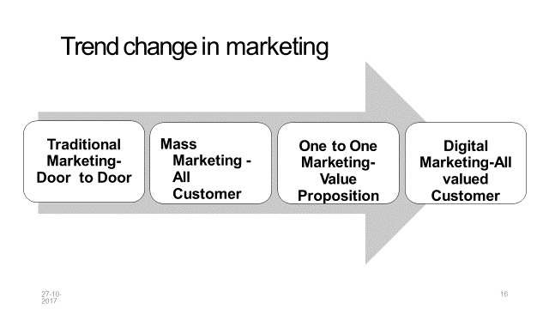
Digital marketing/e-marketing/online marketing/internet marketing (CO1)
E-marketing is the use of information technology in the process of creating, communicating and delivering value to the customers.
E-marketing is also used for managing relationships with the customers in ways that benefit the organization and its stakeholders
E-marketing = traditional marketing + information technology

Slide 19
Marketing Practices For The Digital World (CO1)
1) Identify the Target Audience
Before you even start thinking about the right digital marketing campaign your product, the first step is to define who your target audience is. Identify the goal of your campaign. Does it aim to acquire new customers, win back former ones, or retain the current customers?
The message of your campaign and the business offer has to change according to your target audience. Categorizing the audience correctly will make your message more relevant and specific.
2) Develop a Content Marketing Strategy
Marketing your content in the right way can attract more prospects. It can also move them through a marketing funnel to boost your sales and business. That’s why content creation has become such an essential aspect of digital marketing.
To do that, you will need to take your content outside of a blog or article. Although blogging is a useful marketing tool, it is not the complete picture of content marketing. Content marketing is a full-funnel technique that requires you to deliver quality content to the customer, throughout their journey with you.

Slide 20
Marketing Practices For The Digital World (CO1)
3) Build Relevant Content
Most digital marketers have realized that the content you create for various audiences should be created with a solution in mind. In fact, creating relevant content is considered the most effective SEO tactic by nearly 72% of digital marketers.
Relevant content helps customers connect with the real benefits of important trends, products, or services. This content can be in the form of blog posts, articles, whitepapers, or webinars. This practice holds true particularly for the Business-to-Business or B2B service. B2B customers don’t just go looking around online for the latest machinery and gadgets. In fact, they require solutions to help them achieve their business targets, and informative content helps them find that.

Slide 21
Marketing Practices For The Digital World (CO1)
4) Incorporate SEO Tactics
Online search results are the number one driver of traffic to many websites. In fact, search beats social media by more than a whopping 300%. And you thought Instagram was powerful!
As more and more people rely on Google and Bing to answer all their questions, search engine optimization (SEO) has become one of the most profitable areas of digital marketing. But improving your site’s search rankings isn’t always easy.
Building an SEO/SEM action plan requires enlisting the services of trained SEO experts. But once you have ensured that your team is sufficiently trained, you will see them generate the best ROIs. Implementing SEO/SEM involves deep analytics for optimizing your search reach, understanding the nuances of search algorithms, and knowing the best content placement strategies.

Slide 22
Marketing Practices For The Digital World (CO1)
6) Use Accurate Data
Did you know that in just one year, around 20 to 30%of email addresses have become obsolete? An effective data-driven campaign is highly dependent on the accuracy of the data itself. Data cleansing requires removing inaccurate information, typographical errors, syntax errors, and more. Adding relevant information to your existing data is equally important. Successful digital marketing campaigns rely heavily on your data-cleansing techniques.
User details like physical addresses, contact numbers, social handles, and more can make your data precisely targeted and responsive. Nowadays, there are several specialized companies that can perform regular email hygiene and email appends to ensure the accuracy and integrity of your data.

Slide 23
Marketing Practices For The Digital World (CO1)
7) Employ Email Campaigns
If you thought email marketing was a little old-school, think again. Email is alive and well, and it’s an essential part of your digital marketing strategy. All you need to do is use it effectively and it will provide your business with huge results.
According to a study by DMA and Demand Metric, e-mail was found to have a median Return on Investment (ROI) of a massive 3,800%-4,400%. In fact, that figure is four times higher than the ROI of any other marketing channel. Of course, to achieve those results you would need to master the basics, such as:
Ensure that your emails actually get delivered to your prospect's inbox and don’t go to the spam folder.
Write a strong and personalized subject line to get your email opened.
Generate interactions in the email so that the recipient can take the actions that you want them to. Automate the entire process and increase your efficiency.

Slide 24
Marketing Practices For The Digital World (CO1)
8) Utilize Chatbots
Chatbots are the most convenient way for new leads to interact with your business. They’re the direct line between the consumer's problem and the solution that your business can provide. Chatbots have extensive customizable features and easy to use automation actions. Because of this, chatbots can simulate an in-person conversation between your prospects and your salespeople. They improve the user experience and streamline your sales process.
However, simulating and automating conversations using technology comes with its own unique challenges. For instance, if chatbots aren’t employed correctly i.e. scripted logically, they will fail to deliver seamless, consistent, and efficient user experiences.
Chatbots help automate your business and lighten your workload. They inevitably allow your business to flourish. Chatbots ensure that by the time your prospect interacts with your sales team, they have had most of their queries resolved.

Slide 25
Benefits of Digital Marketing (CO1)
What are the Benefits of Digital Marketing?
A powerful digital presence can help your business in multiple ways:
It will make it easier to create awareness and engagement before and after the sale. It will help you convert new buyers into loyal customers.
It will kickstart word-of-mouth advertisement and social sharing to help expand your presence even further.
Lastly, it will shorten the buyer's journey by presenting the right offers at the right time, in the right place.

Slide 26
Types of digital marketing (CO1)
Search engine optimization (SEO)
Pay-per-click advertising
Email marketing
Content marketing
Social media marketing
Affiliate marketing
Influencer marketing

Slide 27
5d's digital marketing(CO1)
The "5 Ds of Digital Marketing" provide a framework for understanding and implementing effective digital strategies. Here's a breakdown based on the information I found:
Digital Devices:
These are the hardware through which users access digital content. Examples include smartphones, tablets, laptops, and smart TVs.
Understanding which devices your target audience uses is crucial for optimizing your marketing efforts.
Digital Platforms:
These are the online environments where users interact, such as social media platforms (Facebook, Instagram, etc.), search engines (Google), and websites.
Choosing the right platforms to reach your audience is essential.
Digital Media:
This refers to the various forms of content used for marketing, including online advertising, social media posts, email marketing, and video content.
Creating engaging and relevant media is key to attracting and retaining customers.

Slide 28
5d's digital marketing(CO1)
Digital Data:
This encompasses the information collected about user behavior and preferences, which is vital for targeted marketing.
Analyzing data allows marketers to understand their audience and optimize their campaigns.
Digital Technology:
This involves the tools and software used to implement digital marketing strategies, such as marketing automation platforms, analytics tools, and AI-powered solutions.
This also includes things such as Augmented reality, and virtual reality.

Slide 29
What is Marketing Concept (CO1)
Marketing concept is a set of strategies that the firms adopt where they analyze the needs of their customers and implement strategies to fulfil those needs which will result in an increase in sales, profit maximization and also beat the existing competition.
The marketing concept has been widely used by companies all over the world in the present age. As per this concept, it is said that for an organization to satisfy the objectives of the organization, the needs and wants of the customer should be satisfied. This theory was first mentioned in Adam Smith’s book “The Wealth of Nations” in 1776 but came into widespread use only 200 years later.
Therefore, marketing can be said as a process of acquiring customers and maintaining relations with them and at the same time matching needs and wants with the services or product offered by the organization, which ensures that the organization will become profitable.

Slide 30
What are Needs, Wants and Demand (CO1)
Marketing concept focuses on the needs, wants and demands of customers. Let us understand them in brief.
1. Needs:
Needs are basic requirements that enable a healthy and active life. If needs are not fulfilled, it will result in the dysfunction of the system, which can result in disability or death. It can be objective as well as physical as in need of food, water and shelter.
2. Wants:
Wants are something that is desired by the person. These are not required for day to day functioning. Wants are not necessary for basic survival and are mostly moulded by cultural influence.
3. Demands:
When the needs and wants are supported by an ability to pay, it becomes a demand.

Slide 31
Types of Marketing Concept (CO1)
Five types of marketing concepts are as follows:
1. Production Concept
2. Product Concept
3. Selling concept
4. Marketing concept
5. Societal marketing concept
Production Concept
This concept was based on the assumption that customers are primarily interested in products which are accessible and affordable. This concept was introduced at a time when business was focused mainly on production. It says that a business will be able to lower costs by producing more quantity or mass production of goods. Solely focusing on producing goods may lead to the firm deviating from its objective.

Slide 32
What is Marketing Concept? (CO1)
Product Concept
The product concept is based on the assumption that customers will be more inclined towards products that are offering more quality, innovative features and top-level performance.
In this type of marketing concept, a business focuses on creating high-quality products and refining it every time in order to develop a better and improved product.
Selling Concept
While the previous two concepts focused on production, the selling concept is focused on selling. It believes that customers will be buying products only when the product is aggressively marketed by the company. It does not focus on building relationships with customers, and ensuring customer satisfaction is also not deemed necessary.

Slide 33
What is Marketing Concept? (CO1)
Marketing Concept
A marketing concept places the centre of focus on the customer. All the activities that are undertaken by an organisation are done keeping the customer in mind. The organisations are more concerned about creating value propositions for the customers, which will differentiate them from the competition.
Societal Marketing Concept
This is the fifth and most advanced form of the marketing concept. Here the focus is on needs and wants of the customer as well as ensuring the safety of the customer and society first. It believes in giving back to society and making the world a better place for all human beings.
This was all about the different marketing concepts.

Slide 34
THE VIRTUAL WORLD – IMPORTANCE (CO1)
The internet, a vast web of computer network, provides a platform for the worldwide users to connect and share data and thus acts as a huge information repository.
The internet has provided the following to the consumers – speed (of search), convenience (of place and time), information and service.
Internet can be accessed through mobile internet devices now.
Simultaneously, companies have gone global, reaching out to consumers located far away.
Internet provides and excellent low cost solutions for better connectivity.

Slide 35
Shift from traditional marketing to digital marketing practices (CO1)
The shift from traditional marketing to digital marketing has been driven by technological advancements, changes in consumer behavior, and the increasing importance of data-driven decision-making. Here’s an overview of the key aspects of this transition:
1. Factors Driving the Shift
Rise of the Internet & Mobile Usage: More people consume content online through smartphones, social media, and search engines.
Cost-Effectiveness: Digital marketing is often more affordable than traditional methods like TV, radio, and print ads.
Data & Analytics: Online platforms provide real-time data, allowing businesses to measure and optimize campaigns.
Personalization & Targeting: Digital marketing allows for precise audience targeting using AI, cookies, and user behavior data.
Consumer Preferences: Consumers prefer online interactions, shopping, and personalized content over traditional ads.

Slide 36
Shift from traditional marketing to digital marketing practices (CO1)
2.Popular Digital Marketing Channels
Search Engine Optimization (SEO) – Improves visibility in search engines.
Pay-Per-Click Advertising (PPC) – Google Ads, Facebook Ads, etc.
Social Media Marketing (SMM) – Instagram, LinkedIn, TikTok, etc.
Content Marketing – Blogs, videos, infographics, and ebooks.
Email Marketing – Personalized and automated email campaigns.
Affiliate & Influencer Marketing – Leveraging third-party promotions.
3. Challenges in Digital Transition
Adapting to new technologies & platforms.
Increased competition and digital noise.
Privacy concerns & evolving regulations .
Constant need for content creation & engagement.

Slide 37
Shift from traditional marketing to digital marketing practices (CO1)
4. Future Trends
AI-driven marketing automation.
Voice search & conversational marketing.

Slide 38
Shift from traditional marketing to digital marketing practices (CO1)
Engaging the customers on internet
Blogs
Online Communities
Facebook Pages
Twitter
Youtube
Podcasts / Webiners

Slide 39
Case – Nike Company (CO1)
Company Overview
Nike, a global leader in sports apparel and footwear, has traditionally relied on high-profile sponsorships, TV commercials, and print ads. However, with the rise of digital platforms and changing consumer behavior, Nike shifted its marketing strategy to focus on digital marketing, data analytics, and direct-to-consumer (DTC) engagement.
1. Challenges Nike Faced in Traditional Marketing
High Advertising Costs: TV, billboards, and celebrity endorsements were expensive and lacked precise targeting.

Slide 40
Case – Nike Company (CO1)
Limited Customer Interaction: Traditional ads provided little room for two-way engagement with consumers.
Changing Consumer Behavior: Millennials and Gen Z audiences were shifting towards digital platforms, online shopping, and social media.
Dependency on Retailers: Nike relied heavily on third-party retailers for sales, limiting direct engagement with customers.
2. Transition to Digital Marketing
Nike adopted an integrated digital marketing strategy to enhance customer experience, build direct relationships, and increase sales through digital channels.

Slide 41
Case – Nike Company (CO1)
A. Social Media & Influencer Marketing
Leveraged Instagram, Twitter, Facebook, and TikTok for brand storytelling and engagement.
Partnered with influencers and micro-influencers to reach niche audiences.
Created viral campaigns like "You Can't Stop Us" (2020), which gained millions of views and engagement.
B. Data-Driven Digital Advertising
Shifted budget from TV commercials to online ads (Google Ads, Facebook Ads, and programmatic advertising).

Slide 42
Case – Nike Company (CO1)
Used AI and big data to create personalized marketing campaigns based on user behavior.
Focused on retargeting campaigns to bring back potential customers who visited their website but didn’t purchase.
C. E-Commerce & Direct-to-Consumer (DTC) Strategy
Enhanced Nike’s website and mobile app for seamless shopping experiences.
Launched the Nike Membership Program, offering exclusive content, discounts, and early access to products.

Slide 43
Features of the new internet (Web 2.0) (CO1)
Content sharing [through emails, direct messaging, FTP etc]
Discussion forums
Social networking
Tagging
Folksonomies [using Hash tag]
Collaboration
blogging

Slide 44
Modern Digital Consumer & the digital journey (CO1)
Why the consumer of today cannot avoid being digital?
Digitalization helps the consumers with:
Communication with the company
Delivering and getting a message from the companies
To engage in e-commerce
To get information in less time and cost
To make informed purchase decisions
Financial transactions through internet

Slide 45
Modern Digital Consumer & the digital journey (CO1)
The modern digital consumer is a tech-savvy, informed, and empowered individual who navigates the world of products and services with a blend of online and offline interactions. Their digital journey is a dynamic and personalized experience, shaped by their needs, preferences, and the ever-evolving digital landscape.
Characteristics of the Modern Digital Consumer:
Informed and Empowered: They have access to a wealth of information at their fingertips, enabling them to research products, compare prices, and read reviews before making a purchase.

Slide 46
Modern Digital Consumer & the digital journey (CO1)
Connected and Mobile: They are constantly connected through their smartphones and other devices, allowing them to browse, shop, and interact with brands anytime, anywhere.
Demanding and Personalized: They expect personalized experiences tailored to their individual needs and preferences, and they are not afraid to switch brands if their expectations are not met.
Social and Influenced: They are active on social media platforms, where they seek recommendations from friends, family, and influencers, and they are influenced by online reviews and ratings.
Value-Driven: They are conscious of their spending and seek value for their money, looking for the best deals and discounts.

Slide 47
Modern Digital Consumer & the digital journey (CO1)
The New Consumer's Digital Journey:
The digital journey of a modern consumer is a non-linear and multi-touchpoint process, which can be broadly divided into the following stages:
Awareness: The consumer becomes aware of a need or a product/service through various channels, such as social media, online ads, or word-of-mouth.
Consideration: The consumer researches the product/service, compares options, and reads reviews to make an informed decision.
Purchase: The consumer makes the purchase through an online or offline channel, depending on their preference and convenience.

Slide 48
Modern Digital Consumer & the digital journey (CO1)
Post-Purchase: The consumer may leave a review, share their experience on social media, or contact customer service for any queries or concerns.
Loyalty: If the consumer is satisfied with the product/service and the overall experience, they may become a loyal customer and make repeat purchases.

Slide 49
Modern Digital Consumer & the digital journey (CO1)
Let's explore a hypothetical case study of a modern digital consumer and their journey, focusing on the purchase of a new laptop.
Case Study: Anya's Laptop Purchase
Anya, a 28-year-old marketing professional, needs a new laptop for both work and personal use. Her current laptop is outdated and struggling to keep up with her demands. Anya is a modern digital consumer: tech-savvy, informed, and actively uses various online platforms.

Slide 50
Modern Digital Consumer & the digital journey (CO1)
Anya's Digital Journey:
Awareness (Problem Recognition): Anya recognizes the need for a new laptop. Her old laptop is slow, has poor battery life, and can't handle the software she uses for work. She starts noticing ads for laptops on websites she visits.
Consideration (Information Search & Evaluation):
Online Research: Anya begins her research online. She visits tech review websites (e.g., CNET, TechRadar), reads articles comparing different laptop models, and checks specifications.

Slide 51
Modern Digital Consumer & the digital journey (CO1)
. Social Media: Anya joins online communities related to technology and asks for recommendations from friends and colleagues on social media platforms like Twitter and LinkedIn.
YouTube Reviews: She watches video reviews on YouTube to see laptops in action and get a better understanding of their features and performance.
Brand Websites: Anya visits the websites of major laptop brands (e.g., Dell, HP, Apple) to explore their latest offerings and compare models.
Purchase (Decision & Action):
Omnichannel Experience: Anya decides on a specific model after researching extensively. She checks for availability and pricing on both online retailers (e.g., Amazon, Flipkart) and the brand's official website.

Slide 52
Modern Digital Consumer & the digital journey (CO1)
Online Purchase: She ultimately decides to purchase the laptop from an e-commerce website that offers a good deal and fast shipping. She uses her mobile phone to complete the purchase.
Post-Purchase (Experience & Feedback):
Social Sharing: After receiving her new laptop, Anya is thrilled with its performance. She shares her positive experience on social media and leaves a review on the e-commerce website where she bought it.
Brand Interaction: She follows the laptop brand on social media and subscribes to their newsletter to stay updated on new products and offers.
Loyalty :

Slide 53
Marketing strategies for the digital world (CO1)
Email Marketing.
Social Media Marketing.
Pay-Per-Click Marketing (Google Ads)
Search Engine Optimization. [SEO]
Influencer Marketing.
Content Marketing.
Viral Marketing.

Slide 54
Types of Digital Consumers (CO1)
The Six Types of Digital Consumers from Scott Valentine
The motivation for the insights were to understand how consumers continue to incorporate digital media into their purchase process, exploring which sites and technology consumers use in the process of making both online and in-store purchases and why. Of all the consumers who utilized digital at least once in their purchase pathway, six distinct segments emerged. The segments, as identified by GroupM Next, are said to be:
Digitally Driven Segment
Calculated Shoppers
Basic Digital Consumers
Retail Scouts
Brand Scouts
Eternal Shoppers

Slide 55
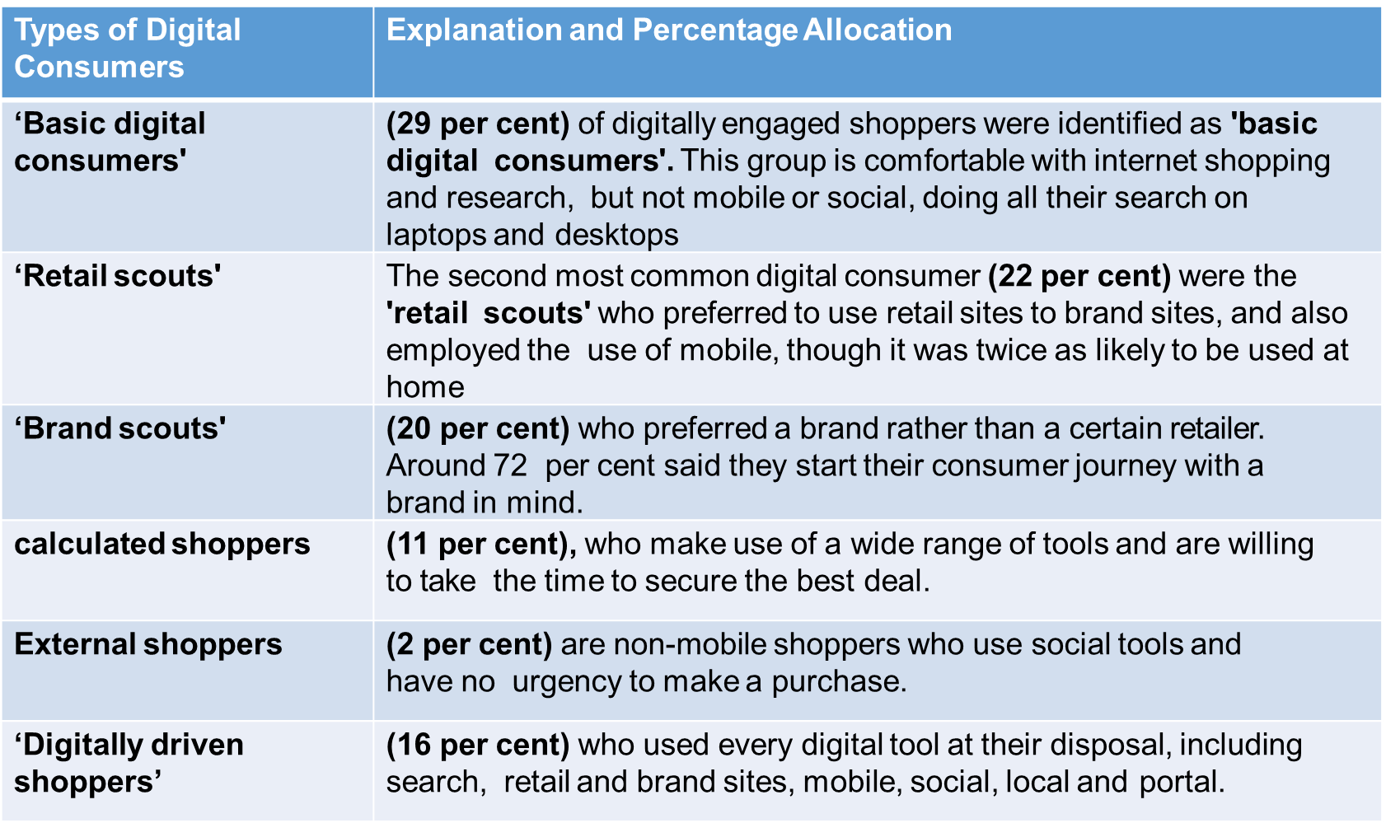
Types of Digital marketing (CO1)

Slide 56
Daily Quiz
Daily Quiz
Question: SEM means __ (a) Search engine marketing (b) Social engine marketing (c) Super e-marketing (d) strategic email marketing
Question: __ marketing refers to achieving marketing objectives through applying digital technologies such as web sites (a) Internet (b) digital (c) email (d) viral
Question: A lead is useful for (a) A marketing staff (b) A team leader (c) Company Chairman (d) An industry making lead products

Slide 57
Weekly Assignments
What do you mean by SEO?
What are the various fields in Digital Marketing?
Why will you prefer Digital Marketing over Traditional Marketing?
What is SEM?
Explain Digital marketing?
What are the different types of Digital Marketing?
What do you know about Viral Marketing?
Do you find anything wrong with the Digital Marketing tactics that we are adhering to right now? If yes, how would you like to change it?
What are the skills needed for Digital Marketing?
What attracted you to the Digital Marketing industry?

Slide 58
Topic Links
https://www.youtube.com/watch?v=aC-DwwgqG6A
https://www.youtube.com/watch?v=KlTTWj4wTqE
https://www.youtube.com/watch?v=lEF8yxSDejk
https://academy.hubspot.com/courses/digital-marketing
https://iide.co/dmlc/?utm_source=Google_LP&utm_medium=Online_Digital_Marketing&utm_campaign=LP_Webinar&gclid=EAIaIQobChMIicviodvE9AIV-5JmAh0IIwYEEAAYAyAAEgL-zfD_BwE

Slide 59
MCQ
1. What are some examples of digital marketing?
Social Media Marketing
Search Engine Marketing
Search Engine Optimisation
All of the above
2. The term Digital Marketing was first used in the .............
1999s.
1990s
1980s.
1989s.
3. What is the best way to promote a business with social media?
Choose the Right Platforms
Encourage Engagement
Provide Value & Don’t Over-Promote
All of the above
4. What do you mean by Digital marketing?
Digital marketing is referred to as online marketing, web marketing, and internet marketing.
Analog Marketing
Shop
None of the above

Slide 60
MCQ
5) Which of the following is the correct depiction of Digital Marketing?
E-mail Marketing
Social Media Marketing
Web Marketing
All of the above
6) Which of the following is incorrect about digital marketing?
Digital marketing can only be done offline
Digital marketing cannot be done offline.
Digital marketing requires electronic devices for promoting goods and services.
In general, digital marketing can be understood as online marketing, web marketing, and e-mail marketing.
7) What is the name of the process in which marketing is achieved by incorporating tools, techniques, electronic devices, technologies, or systems?
Internet Marketing
Direct Marketing
Electronic Marketing
Interactive Marketing
8) What will happen if white space is repeatedly used around the object?
It will reduce the readability
It will create a border
It will make it more appealing by augmenting the object
All of the above

Slide 61
Glossary Questions
Marketing automation, Digital platform, Native advertising, Viral marketing, Digital devices
_______ include smartphones, tablets, desktop computers, TVs and gaming devices.
_______ is the process of leveraging software to automate repetitive marketing tasks.
________ is a sales technique that involves organic or word-of-mouth information about a product or service to spread at an ever-increasing rate
_________is a browser or apps from the major platforms or services, that’s Facebook (and Instagram), Google (and YouTube), Twitter and LinkedIn.
5. _________ is the use of paid ads that match the look, feel and function of the media format in which they appear.

Slide 62
Old Question Papers
No previous question paper as the subject has been newly introduced in the autonomous

Slide 63
Expected Questions for University Exam
Expected Questions for University Exam
Q1.Explain what do you mean by term new digital world ? What are the key trends driving shift from tradition to digital marketing practices ?
Q2. Discuss the need for digital marketing in today’s digital world ?
Q3.Explain the 7 Ps of digital marketing in detail ?
Q4.Explain in detail the steps involved while crafting a digital marketing strategy ?
Q5.Throw light on the various market Strategies for the digital world.
Q6. Briefly discuss new digital paradigm changing the marketing world?
Q7. State the different types of Digital Marketing?
Q8. Name some useful Digital Marketing tools?
Q9. Explain PPC or Pay Per Click advertising?
Q10. State the limitations of Online Marketing.
Q11. Explain what do you know about Email Marketing.
Q12. Give reasons why Online marketing is preferred over Offline marketing.

Slide 64
RECAP
Digital marketing is a subset of traditional marketing. It promotes your brand or products using digital channels such as the internet, emails and mobile phones, as opposed to more traditional media such as print, radio, TV or billboards. Finding new customers is the main aim of digital marketing. It has the advantage over traditional marketing techniques because online programs such as Google Analytics exist which enable you to analyze your marketing campaigns in real time. This is far faster than any non-digital technique.

Slide 65
References
MoutsyMaiti: Internet Marketing, Oxford University Press India (June, 2017)
Vandana, Ahuja; Digital Marketing, Oxford University Press India (January, 2021).
Eric Greenberg, and Kates, Alexander; Strategic Digital Marketing: Top Digital Experts Share the Formula for Tangible Returns on Your Marketing Investment; McGraw-Hill Professional (October, 2013).
Ryan, Damian; Understanding Digital Marketing: marketing strategies for engaging the digital generation; Kogan Page (3rd Edition, 2014).
Tracy L. Tuten& Michael R. Solomon : Social Media Marketing (Sage Publication

Slide 66
Noida Institute of Engineering and Technology, Greater Noida
Thank You

